Slide 1
THERMODYNAMICS II
Dr. V. V. Dhole
Dept. Of Chemistry
S.C.S.College, Omerga.

Slide 7
7.2 THE SECOND LAW OF THERMODYNAMICS
Two classical statements of the second law
Kelvin–Planck statement
Clausius statement.

Slide 8
The Kelvin–Planck statement:
It is impossible to construct a device that will operate in a cycle and produce no effect other than the raising of a weight and the exchange of heat with a single reservoir. See Fig. 7.6.

Slide 9
The Clausius statement:
It is impossible to construct a device that operates in a cycle and produces no effect other than the transfer of heat from a cooler body to a hotter body. See Fig. 7.7.

Slide 11
Equivalence of the two statements
(source)
=0
(sink)

Slide 12
(Impossible device)

Slide 13
7.5 THE CARNOT CYCLE

Slide 16
7.6 TWO PROPOSITIONS REGARDING THE EFFICIENCY OF A CARNOT CYCLE
First Proposition It is impossible to construct an engine that operates between two given reservoirs and is more efficient than a reversible engine operating between the same two reservoirs.
Second Proposition All engines that operate on the Carnot cycle between two given constant temperature reservoirs have the same efficiency.

Slide 17
The thermodynamic scale

Slide 19
How is the ideal-gas temperature determined ?

Slide 22
7.8 Ideal versus Real Machines

Slide 29
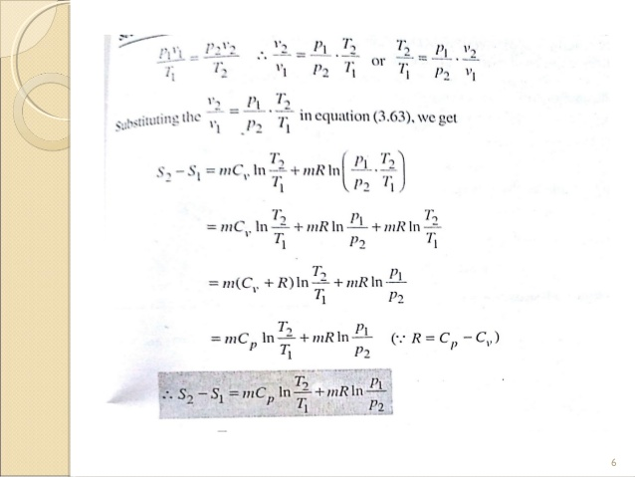

Slide 31
First law allows us to calculate the energy changes in processes. But these changes do not suggest spontaneity.
Examples: H, U. Distinction between spontaneous and non-spontaneous come in the form of Second law: Kelvin’s statement: “No process is possible in which the sole result is the absorption of heat from the reservoir and its complete conversion to work”.
Compare with first law….complete process Spontaneous process has to transfer part of the energy

Slide 32
Entropy – measures the energy lost
Second law in terms of entropy: Entropy of an isolated system increases in the course of a spontaneous change: ΔStot > 0
For this we need to show that entropy is a state function
Definition: dS = dqrev/T
For a change between i and f: ΔS = ʃif dqrev/T
Choose a reversible path for all processes

Slide 33
qrev = -wrev Wrev is different from w
ΔS = qrev/T = 1/T∫i
f dqrev = nRlnVf
/Vi
dssur = dqsur,rev/Tsur = dqsur/Tsur
Adiabatic, ΔSsur = 0

Slide 34
Statistical meaning of entropy Molecules can possess only certain number of energy states.
They are distributed in energy levels. Population refers to the average number of molecules in a given state. This can be measured.
As temperature increases, populations change. Number of molecules, Ni found in a given state with energy Ei, when the system is at thermal equilibrium at T is,
Ni = Ne-Ei/kT/Σe-Ei/kT
S = k ln W
W – number of microstates
W = 1, S = 0
Entropy as a state function Carnot’s cycle or Carnot cycle shows that.

Slide 35
Entropy denoted as S. The above mentioned disorder is the manifestation of entropy
the entropy change is inversely proportional to the temperature. ∆S is related with q and T for a reversible reaction as :
∆S = q T rev (6.18) The total entropy change ( ∆Stotal) for the system and surroundings of a spontaneous process is given by
∆Stotal= ∆Ssystem + ∆surr>0
When a system is in equilibrium, the entropy is maximum, and the change in entropy, ∆S = 0.
We can say that entropy for a spontaneous process increases till it reaches maximum and at equilibrium the change in entropy is zero. Since entropy is a state property, we can calculate the change in entropy of a reversible process by
∆Ssys = qsys rev / T
We find that both for reversible and irreversible expansion for an ideal gas, under isothermal conditions, ∆U = 0, but ∆Stotal i.e., ∆Ssys + ∆Ssurr is not zero for irreversible process. Thus, ∆U does not discriminate between reversible and irreversible process, whereas ∆S does.

Slide 36
Gibbs Energy and Spontaneity
We have seen that for a system, it is the total entropy change, ∆Stotal which decides the spontaneity of the process. But most of the chemical reactions fall into the category of either closed systems or open systems. Therefore, for most of the chemical reactions there are changes in both enthalpy and entropy. It is clear from the discussion in previous sections that neither decrease in enthalpy nor increase in entropy alone can determine the direction of spontaneous change for these systems. For this purpose, we define a new thermodynamic function the Gibbs energy or Gibbs function, G, as
G = H – TS Gibbs function, G is an extensive property and a state function. The change in Gibbs energy for the system, ∆Gsys can be written as
∆Gsys = ∆Hsys- T ∆Ssys- Ssys ∆T At constant temperature, ∆ = T 0
∴ ∆G sys= ∆Hsys- T∆S sys Usually the subscript ‘system’ is dropped and we simply write this equation as
∆ G = ∆ H- T ∆ S
Thus, Gibbs energy change = enthalpy change – temperature × entropy change, and is referred to as the Gibbs equation, one of the most important equations in chemistry.
Here, we have considered both terms together for spontaneity: energy (in terms of ∆H) and entropy (∆S, a measure of disorder) as indicated earlier. Dimensionally if we analyse, we find that ∆G has units of energy because, both ∆H and the T∆S are energy terms, since T∆S = (K) (J/K) = J.

Slide 37
Now let us consider how ∆G is related to reaction spontaneity
Gibbs free energy Allows us to determine spontaneity considering the system alone May be thought to quantify the maximum amount of nonexpansion work the system can perform Is a state function
G = H – TS
∆G = ∆H - T∆S (T, P = const)
∆G < 0 corresponds to a spontaneous process

Slide 38
We know, ∆Stotal = ∆Ssys + ∆Ssurr
If the system is in thermal equilibrium with the surrounding, then the temperature of the surrounding is same as that of the system. Also, increase in enthalpy of the surrounding is equal to decrease in the enthalpy of the system. Therefore, entropy change of surroundings, ∆Hsys is the enthalpy change of a reaction, T∆Ssys is the energy which is not available to do useful work. So ∆G is the net energy available to do useful work and is thus a measure of the ‘free energy’. For this reason, it is also known as the free energy of the reaction.
∆G = ∆H - T∆S
∆G gives a criteria for spontaneity at constant pressure and temperature.
(i) If ∆G is negative (< 0), the process is spontaneous.
(ii) If ∆G is positive (> 0), the process is non spontaneous.

Slide 41
GIBBS ENERGY CHANGE AND EQUILIBRIUM
We have seen how a knowledge of the sign and magnitude of the free energy change of a chemical reaction allows: (i) Prediction of the spontaneity of the chemical reaction. (ii) Prediction of the useful work that could be extracted from it. So far we have considered free energy changes in irreversible reactions. Let us now examine the free energy changes in reversible reactions. ‘Reversible’ under strict thermodynamic sense is a special way of carrying out a process such that system is at all times in perfect equilibrium with its surroundings. When applied to a chemical reaction, the term ‘reversible’ indicates that a given reaction can proceed in either direction simultaneously, so that a dynamic equilibrium is set up. This means that the reactions in both the directions should proceed with a decrease in free energy, which seems impossible. It is possible only if at equilibrium the free energy of the system is minimum. If it is not, the system would spontaneously change to configuration of lower free energy.

Slide 42
So, the criterion for equilibrium A + B :::::::: C + D ;
is ∆rG = 0
Gibbs energy for a reaction in which all reactants and products are in standard state, ∆rG* is related to the equilibrium constant of the reaction as follows:
0 = ∆rG* + RT ln K OR
∆rG* = – RT ln K OR
∆rG* = – 2.303 RT log K
∆rG* = – RT ln K = ∆H-T ∆S

Slide 43
THE END

